Slide 1

CASE STUDY ON
WHY JABONG FAILED

Slide 2
PD15-079
SACHIN KUMAR
TEAM MEMBERS
GROUP 1
PD13_231
ASHUTOSH JOGI
PD13_172
GOVIND AGGARWAL
VAIBHAV GUPTA
PD14_220

Slide 3
WHAT’S COMING?
INTRODUCTION OF THE PROJECT
01
DETAILS ABOUT JABONG
02
PERFORMANCE OF JABONG – ANALYSIS
03
STAGES AND REASONS OF FAILURE
04
RECOMMENDATIONS
05
CHALLENGES AND LEARNING
06

Slide 4





WHY JABONG FAILED
STEP 1
STEP 2
STEP 3
STEP 4
Study the problem statement.
Browsing internet to gather information about Jabong
Studying all the applicable frameworks and relate them with our problem
Sorting and Applying research material into the applicable timeline
Failure Cause Analysis and driving Conclusions

Slide 5

DETAILS ABOUT JABONG
E-commerce portal started in Oct 2011 to take fashion online in India to next level bringing international brands.
Founded by Praveen Sinha, Arun Chandra Mohan, Lakshmi Potluri and Manu Kumar Jain having headquarters at Gurugram, NCR, India.
The company launched its first TV campaign in March 2012.
It became India’s biggest fashion and lifestyle giant for men, women and kids.
In July 2016, Flipkart’s myntra acquired Jabong for US $70 million.
In 2020, it was completely shut down.

Slide 6
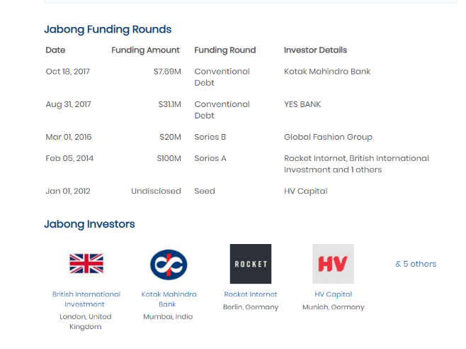
JABONG INVESTORS

Slide 7
JABONG BUSINESS MODEL CANVAS
JABONG.COM BUSINESS MODEL CANVAS
KEY PARTNERS Sourcing directly from top lifestyle brand partners. (Warehousing) Online partners like Yepme and DonebyNone. (Market Place) Private Label of Jabong.com jaVAS (Logistics partner, an arm of Jabong itself) | KEY ACTIVITIES Supply Chain optimization Marketing (Digital and Traditional) Innovation | VALUE Convenience Wide assortment to choose from. High Quality customer service. Flexible payment options One of the fastest delivery times Open box delivery Customization and Innovation | RELATIONSHIPS Self Service Automated Services Jabong Community Customer Care Complaint resolution Co-Creation (reviews) | CLIENTS It is Basically Mass Market 50-60% of the total sales are from small towns. Not the top 45 cities, but the next batch after that. Youth, who spend on discretionary activities, want to look and feel good.
 | KEY RESOURCES Delivery staffing Technology Warehousing IT Infrastructure |  | CHANNELS Website (Jabong.com) (Jabongworld.com) Affiliate Programs
COST CENTERS Marketing (TVC) Technology Cost Fulfilment (Logistics) |  | REVENUE STREAMS Retail Sales (Inventory model) Commission on third party sales (Market place model) Advertisement revenue

Slide 8
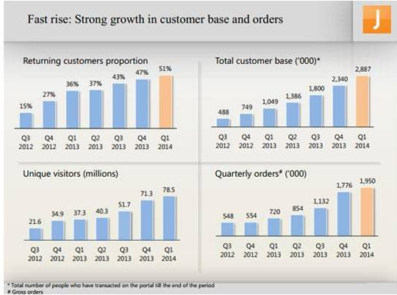
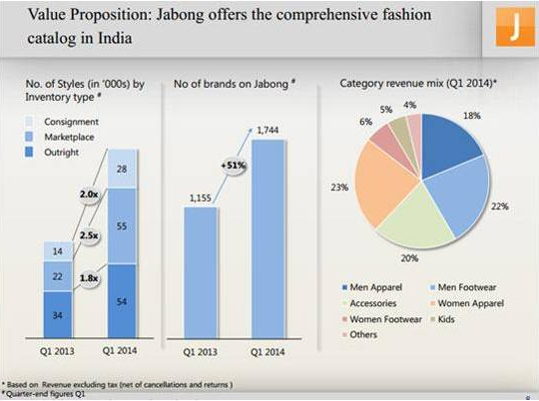
PERFORMANCE ANALYSIS
The growth in the customer base of Jabong, showing continuous growth in the number of customers visiting Jabong.com as well as the number of orders placed by the customers.
The Number of brands and the variety of the had continuous growth Year-on-Year.

Slide 9
STAGES OF FAILURE
Acquisition of Myntra by Flipkart in 2014.
Acquisition of Jabong by Flipkart’s Myntra in 2016.
Complete shutdown of Jabong in 2020.

Slide 10
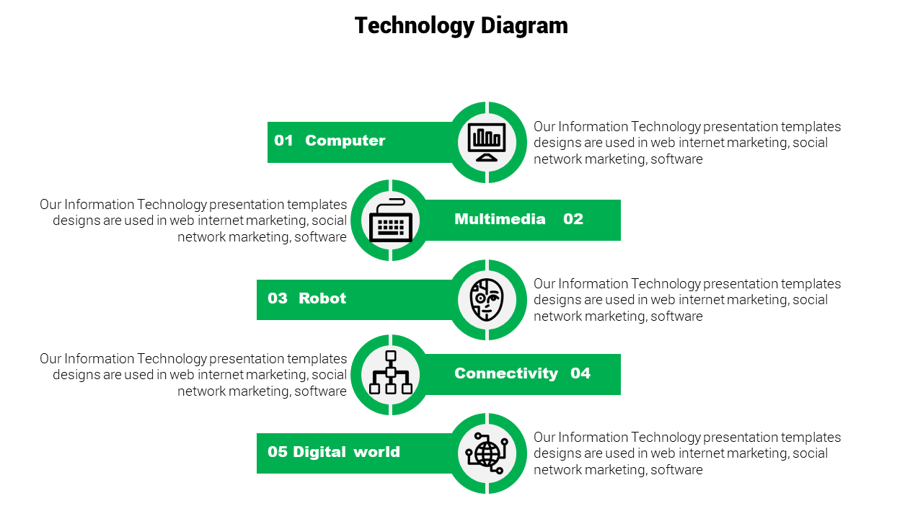
he
REASONS OF FAILURE OF JABONG
01 CORPORATE GOVERNANCE
Co-founders leaving the company one by one and hence without any consistent leadership the vision of the company was also not consistent.
Doing the same thing as was done by the competitors. Competitors like Flipkart/Myntra and amazon had large funds and was able to provide discounts and offers to retain customers.
02 No Competitive Edge over Competitors
With change in the management as co-founders leaving the company and change in the focus with every new leader, company could not focus on any one goal which resulted efforts being wasted.
03 LACK OF FOCUS
With Employees getting fired after the acquisition of Jabong by Flipkart/Myntra, there was very low trust in the employees about job security and hence lack of motivation.
04 LACK OF TRUST AMONG EMPLOYEES
With Investors sole focus on the good exit, there was no real focus on the opportunity coming to them in terms of the Exit offers presented to them by various big names such as Amazon (offering $1.2 Bn in 2015).
05 EXIT TIMING
*all the above causes and Observations are based only on data that we have fetched from internet about Jabong.

Slide 11
THINGS THAT COULD’VE BEEN DONE DIFFERENTLY
he
Market was on a growing trend with increase in the economy and introduction of newer technology and cheaper internet favoured e-commerce businesses
01 WAIT FOR THE MARKET TO GROW
There was never a same target of the company as the main focus of the investors was to find a good exit deal. The focus should’ve been on Growing the brand as it was making name for itself and growing rapidly.
02 KEEPING THE FOCUS ON THE SINGLE TARGET
There was nothing that Jabong was doing and it’s competitors wasn’t. The focus should’ve been on the various marketing that they initiated like Same Day Delivery, collaboration with Stylista.com, etc.
03 CREATING A DIFFERENTIATING FACTOR AND MAINTING IT
IF the target was to have a good exit, the management should’ve evaluated their value as per market and close out the deals that were offered to them.
(Amazon offering $1.2 Bn in 2015)
04 BETTER EXIT TIMING
The major investors (Rocket Internet) having it’s focus on exiting, the Co-founders could look for other investment options as the competition had more funds and could offer discounts and other deals to the customer to retain them.
05 FINDING OTHER INVESTMENT SOURCE
*all the above Insights and Observations are based only on the data that we have fetched from Internet

Slide 12
CHALLENGES FACED
01
02
03
BROWSING INTERNET FOR DATA
LINKING FRAMEWORKS
DECIDING THE TIMELINE
Finding relevant data was the main task of this case study and it took most of our time.
Linking this case study to any framework was very challenging for us as this was not fitting into any criteria of the known frameworks.
The sequence of presenting and aligning data was something that we struggled with as multiple events were happening at different phase of the study.

Slide 13
WHAT WE ARE TAKING WITH US
AFTER THIS PROJECT?
WEB DATA VALIDATION : Knowledge of referring various websites and validating whether the data represented by them is correct or not.
01
Major Leanings
FRAMEWORKS and how they can used in actual case studies. How to link them with the available question present in front of us.
02
Taking Data from the internet and actually interpreting results and insights from it to help businesses with recommendations.
03
Team Work and Handling Pressure of close Deadlines.
04

Slide 14

This is the END of our Presentation.
And your turn to ask us anything related to the Case Study

Slide 15


